Slide 1
Solar tracking system
(dual axis)

Slide 2
Why India needs solar energy?
Very poor in Non-renewable energy resources.
Unlike other countries availability of sunlight in a day is pretty good.
Huge population.
High cost to generate electricity.

Slide 3
Why we need this additional setup?
It improves efficiency by tracking sun all day long.
in devices which need energy on the go.
In devices which are autonomous.

Slide 4
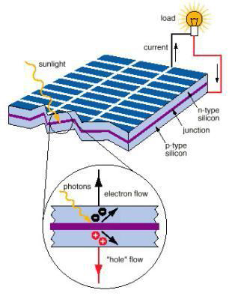
How does a solar panel works?

Slide 5
Hardware&sofware requirements
Arduino UNO.
Servo motors
Solar panel
Light sensors
Resistors(10k)
Arduino IDE

Slide 6
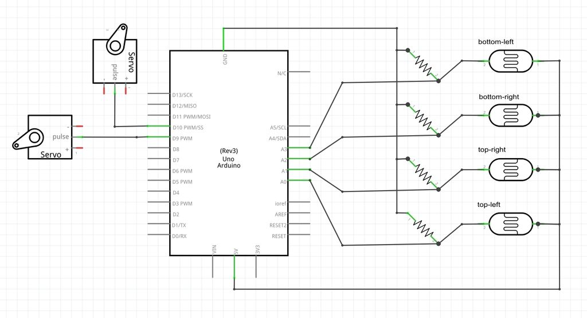
Sensor system

Slide 7
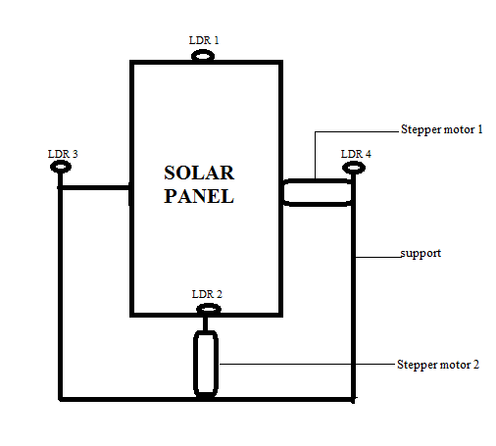
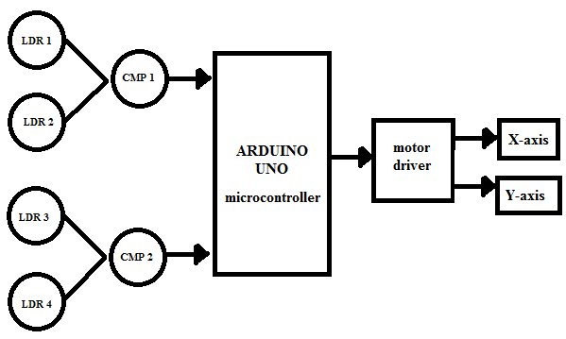
Working mechanism
As long as the sun direction changes
there would be changes in the voltages
generated at LDRs.
These analog voltages are fed into microcontroller
Output PWM will be generated in according to the code.
VID_20170623_002123.mp4

Slide 8
Limitations
When there is cloudy atmosphere it is difficult to tracking the sun.
Panel rotations require an extra power from outside of power used that produce by panel itself.
Fixing arrangement of LDR at perpendicular to sun light is somewhat problematic
LDRs are very sensitive elements and so may get damaged in extreme climatic conditions.

Slide 9
Future scope
In Future the conventional energy is not sufficient for use so there is need of use non conventional energy sources .This Project is very useful for power supply in rural areas where we can use high sensitive solar panels which can work in mild sun light also and by connecting number of solar tracker assemblies we will able to produce sufficient large quantity of power which will be able to supply power to medium size village.

Slide 10


